Slide 1


DEBI Chatbot
GROUP 17
PRESENTED TO: Prof. Arya

Slide 2
Problem Formulation
Ontology Using Protégé
Dialog-Flow
Test Cases
Train Cases
Evaluation
Deployment
Summary
Catalogue

Slide 3
01
Problem Formulation

Slide 4

Use Case
DEBI Chatbot
a chatbot that is specialized for answering questions about DEBI scholarship, and for learning purposes we focused on queries on AI/DS track uOttawa.

Slide 5
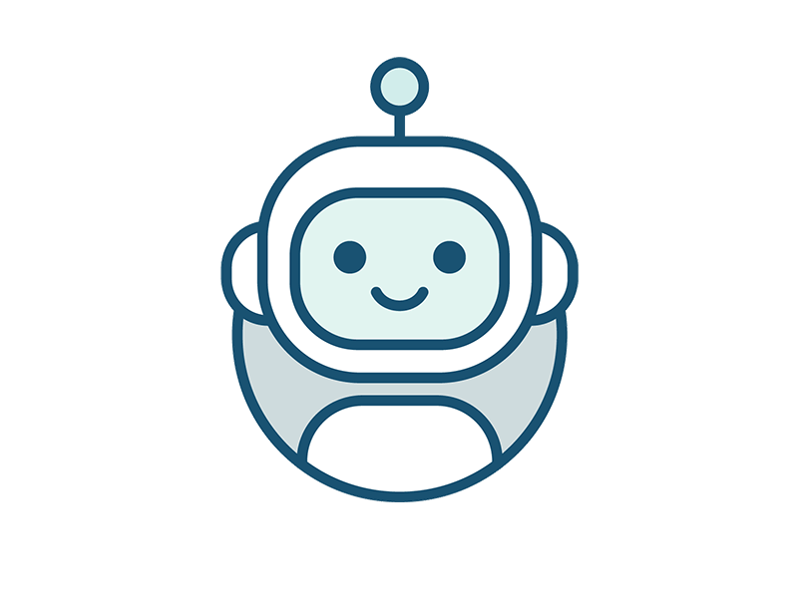
Flow
If difference > 5 Y
Answers
Asks about Graduation Year
You can’t
If month Between(August, January)
User ask about the program
User ask about eligibility to applying
Yes, You can
Else
You can
User ask if they can apply now
else
No (and open time)
Answers
Answers
User ask about application requirement
User ask about application duration

Slide 6
02
Creating Ontology

Slide 7
Ontology with protege
01
02
03
04
Class
object properties
Data properties
Individuals
groups, sets or collections of objects
describing how classes can relate to each other based on their instances
like object properties except their domains are typed literals
A designer can use default text to simulate what text would look like.

Slide 8
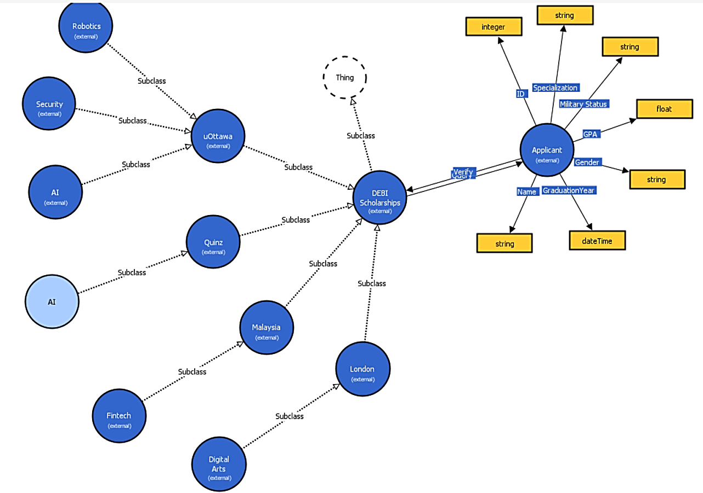
Ontology

Slide 9
03
Dialog-Flow

Slide 10
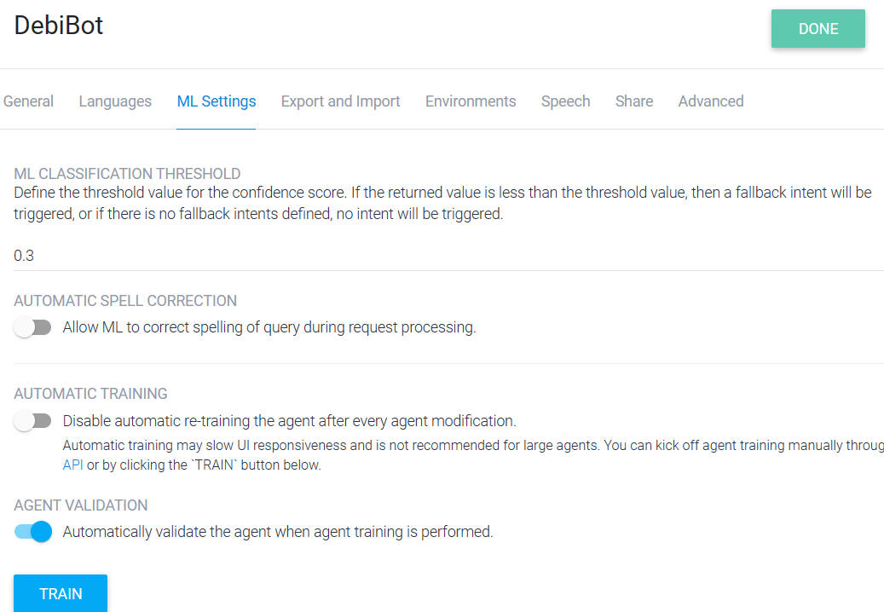

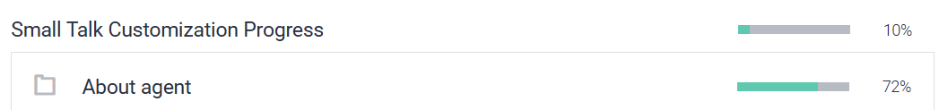
Setup

Slide 11
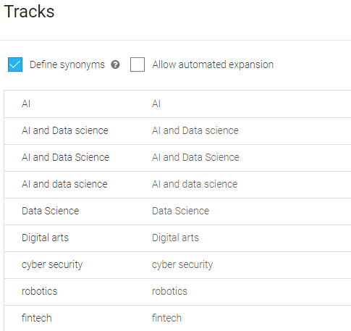
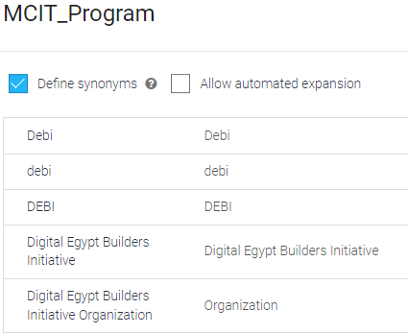
Entities

Slide 12
Intents
We thought it might be good to go through the small talk feature as it’s an everyday question, so, we provided the different versions of the answers about certain topics so, the same user won’t get the same answer every time.
Know Debi
Application Requires
Duration
Opening Time
CanIApply
YearQuery
MaterialsQuery

Slide 13
04
Test Cases

Slide 14
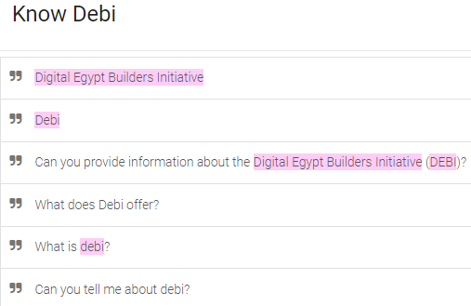
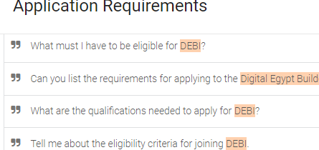
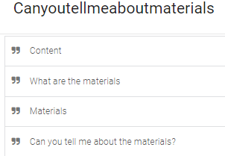
Intents Competency Questions
We added test cases with different potential questions for our chatbot to be trained on

Slide 15
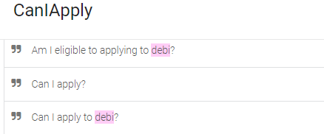
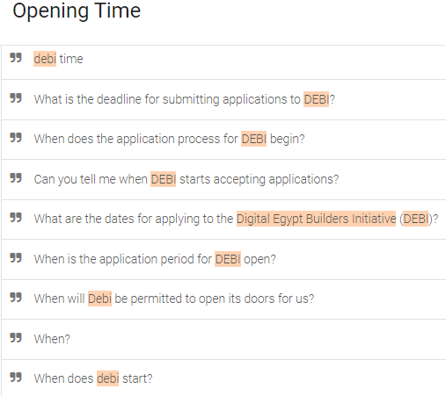
Intents Competency Questions Cont'd

Slide 16
05
Train Cases

Slide 17
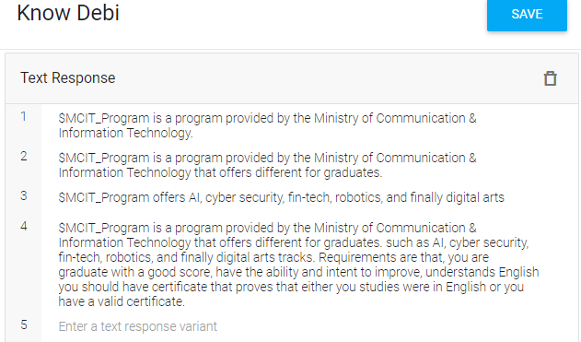
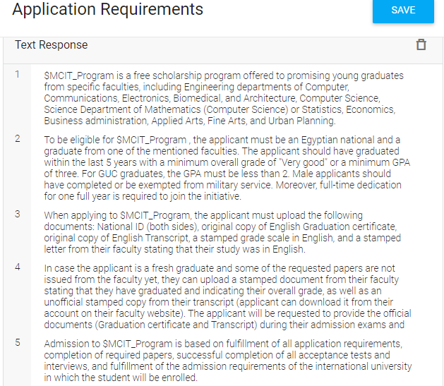
Training Question-Answers
We added multiple answers for our chatbot to be trained on to be trained on generating different answers

Slide 18
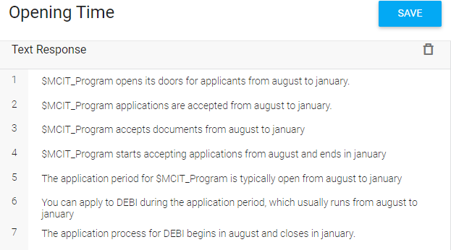
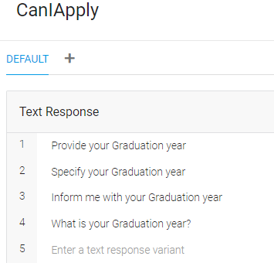
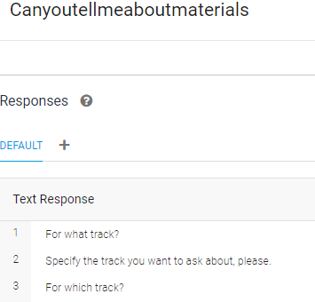
Training Question-Answers Cont'd

Slide 19
06
Evaluation

Slide 20
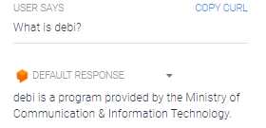
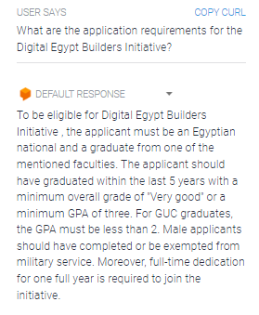
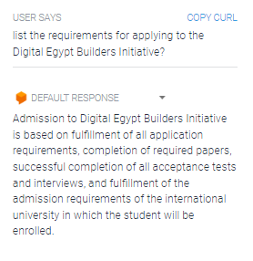
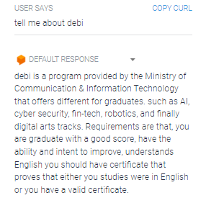
Evaluate to isolate weaknesses
To avoid repeated answers with different answers to questions:

Slide 21
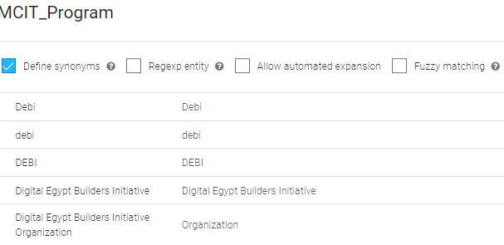
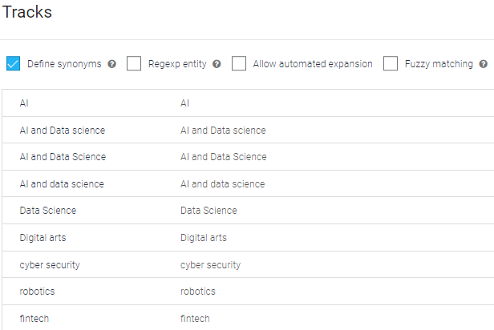
Evaluate to isolate weaknesses Cont’d
We created 2 entities, one called MCIT_Program and the other called Tracks, we did that mainly so that we could reuse the name preferred by user so the user would feel as the chatbot more connected to them.

Slide 22
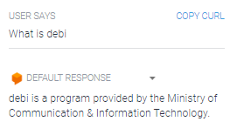
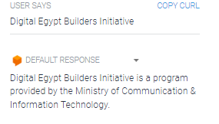


Evaluate to isolate weaknesses Cont’d

Slide 23
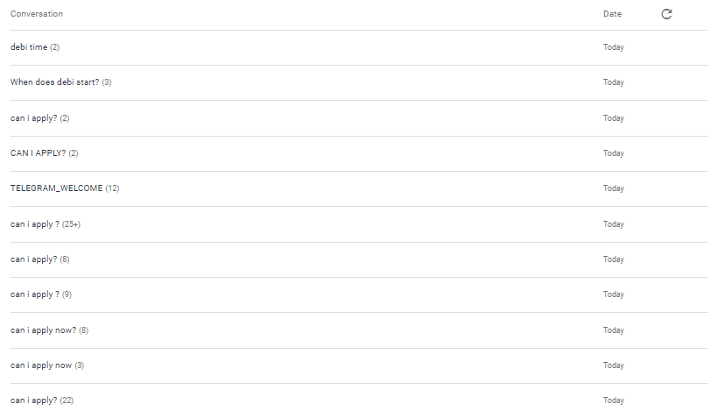
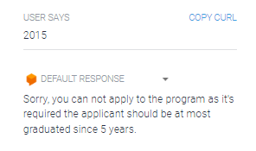
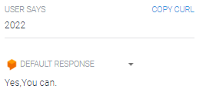
Evaluate to isolate weaknesses Cont’d
We kept on evaluating our chatbot responses to ensure it generates accurate answers depending on the asked questions

Slide 24
07
Deployment

Slide 25
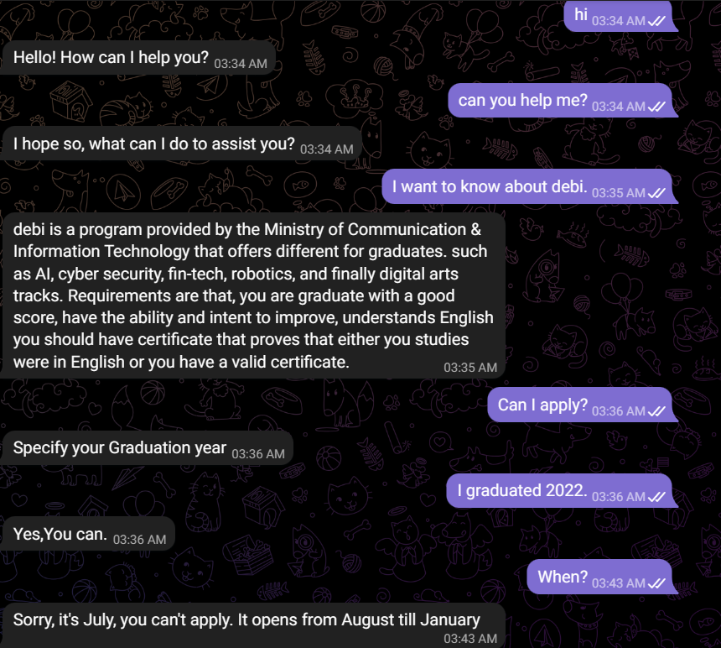
Deployment of DEBI Chatbot
We integrated the chatbot with telegram, we thought that would encourage us more if we really wanted to invest in the idea in the future.
For telegram check this id : @debi_chatbot
https://bot.dialogflow.com/eeb1007f-dcb3-4ab4-8b1a-522ec9a7ea6a

Slide 26
08
Summary

Slide 27
Thanks

